Slide 1
ENG1003 Freshman Seminar for Engineering AAE Design of Path Planning Algorithm for Aircraft Operation Week 4: Path Planning Algorithm and Python Robotics
Dr Li-Ta Hsu and Dr Weisong Wen
Assisted by
Man Hei CHENG (Melvin), Miss Hiu Yi HO (Queenie), Miss Yan Tung LEUNG (Nikki)

Slide 2
A* Path Planning Algorithm

Slide 3
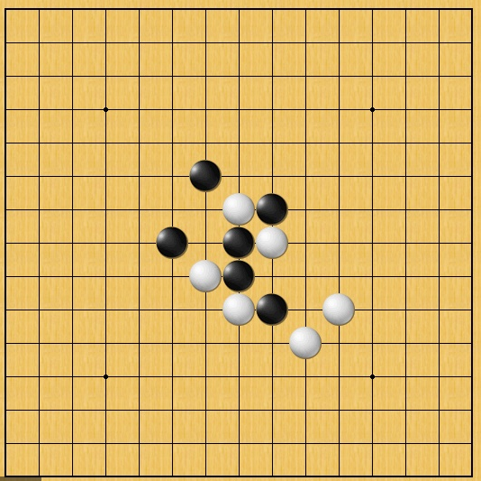
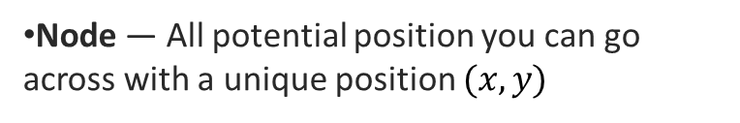
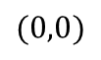
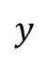
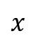
Definition of Path Planning
1 meter for one grid
$$y$$
Node — All potential position you can go across with a unique position $(x,y)$
Search Space — A collection of nodes, like all board positions of a board game.
$$(0,0)$$
$$x$$
Objective of path planning— Find the shortest routes with smallest cost from start node to goal node.
Start node
Goal node
Route 1
How to find the shortest route!
Gobang
Route 2

Slide 4
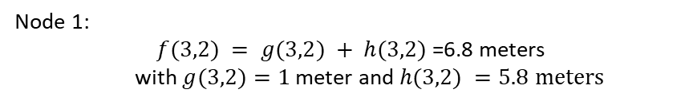
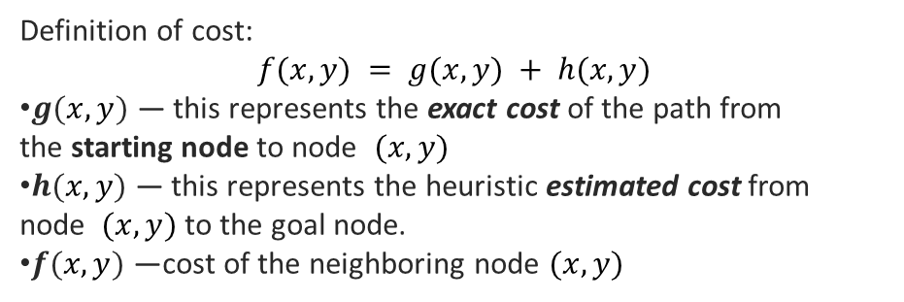
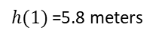
Path Planning using A Star Method
Definition of cost:
$$f(x,y) = g(x,y) + h(x,y)$$
$g(x,y)$ — this represents the exact cost of the path from the starting node to node $(x,y)$
$h(x,y)$ — this represents the heuristic estimated cost from node $(x,y)$ to the goal node.
$f(x,y)$ —cost of the neighboring node $(x,y)$
$$y$$
$h(1)$=5.8 meters
3 meters
Node 1
5 meters
$$(0,0)$$
$$x$$
8 neighboring node and the cost can be calculated as follows!
Start node
Node 1:
$f(3,2) = g(3,2) + h(3,2)$=6.8 meters
with $g(3,2)=1$meter and $h(3,2) =5.8$ $meters$
Goal node
1 meter for one grid

Slide 5
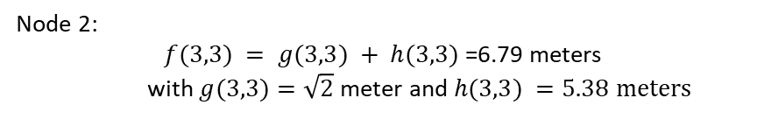
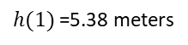
Path Planning using A Star Method
Definition of cost:
$$f(x,y) = g(x,y) + h(x,y)$$
$g(x,y)$ — this represents the exact cost of the path from the starting node to node $(x,y)$
$h(x,y)$ — this represents the heuristic estimated cost from node $(x,y)$ to the goal node.
$f(x,y)$ —cost of the neighboring node $(x,y)$
$$y$$
$h(1)$=5.38 meters
2 meters
Node 2
5 meters
$$(0,0)$$
$$x$$
8 neighboring node and the cost can be calculated as follows!
Start node
Node 2:
$f(3,3) = g(3,3) + h(3,3)$=6.79 meters
with $g(3,3)=\sqrt{2}$meter and $h(3,3) =5.38$ $meters$
Goal node
1 meter for one grid

Slide 6
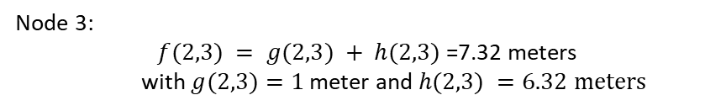
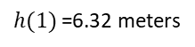
Path Planning using A Star Method
Definition of cost:
$$f(x,y) = g(x,y) + h(x,y)$$
$g(x,y)$ — this represents the exact cost of the path from the starting node to node $(x,y)$
$h(x,y)$ — this represents the heuristic estimated cost from node $(x,y)$ to the goal node.
$f(x,y)$ —cost of the neighboring node $(x,y)$
$$y$$
$h(1)$=6.32 meters
Node 3
2 meters
6 meters
$$(0,0)$$
$$x$$
8 neighboring node and the cost can be calculated as follows!
Start node
Node 3:
$f(2,3) = g(2,3) + h(2,3)$=7.32 meters
with $g(2,3)=1$meter and $h(2,3) =6.32$ $meters$
Goal node
1 meter for one grid
Similar cost calculation method for other 5 nodes

Slide 7
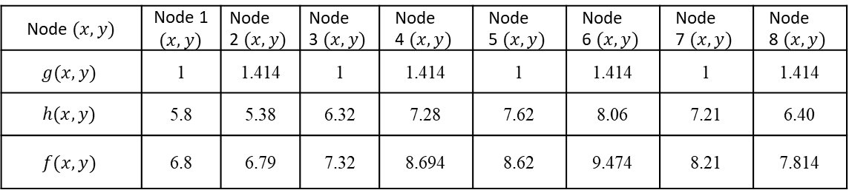
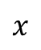
Path Planning using A Star Method
Definition of cost:
$$f(x,y) = g(x,y) + h(x,y)$$
$g(x,y)$ — this represents the exact cost of the path from the starting node to node $(x,y)$
$h(x,y)$ — this represents the heuristic estimated cost from node $(x,y)$ to the goal node.
$f(x,y)$ —cost of the neighboring node $(x,y)$
$$y$$
$h(1)$=5.8 meters
3 meters
Node 1
5 meters
$$(0,0)$$
$$x$$
Start node
Node $(x,y)$ | $\text{Node}$ 1 $(x,y)$ | $$\text{Node} \text{2} (x,y)$$ | $$\text{Node} \text{3} (x,y)$$ | $$\text{Node} \text{4} (x,y)$$ | $$\text{Node} \text{5} (x,y)$$ | $$\text{Node} \text{6} (x,y)$$ | $$\text{Node} \text{7} (x,y)$$ | $$\text{Node} \text{8} (x,y)$$
$$g(x,y)$$ | 1 | 1.414 | 1 | 1.414 | 1 | 1.414 | 1 | 1.414
$$h(x,y)$$ | 5.8 | 5.38 | 6.32 | 7.28 | 7.62 | 8.06 | 7.21 | 6.40
$$f(x,y)$$ | 6.8 | 6.79 | 7.32 | 8.694 | 8.62 | 9.474 | 8.21 | 7.814
Goal node
1 meter for one grid

Slide 8
Path Planning using A Star Method
Definition of cost:
$$f(x,y) = g(x,y) + h(x,y)$$
$g(x,y)$ — this represents the exact cost of the path from the starting node to node $(x,y)$
$h(x,y)$ — this represents the heuristic estimated cost from node $(x,y)$ to the goal node.
$f(x,y)$ —cost of the neighboring node $(x,y)$
$$y$$
Node 2
$$(0,0)$$
$$x$$
8 neighboring node and the cost can be calculated as follows!
Start node
Goal node
Node 2 leads to smallest cost
1 meter for one grid

Slide 9
Calculate the cost of node
Definition of cost:
$$f(x,y) = g(x,y) + h(x,y)$$
$g(x,y)$ — this represents the exact cost of the path from the starting node to node $(x,y)$
$h(x,y)$ — this represents the heuristic estimated cost from node $(x,y)$ to the goal node.
$f(x,y)$ —cost of the neighboring node $(x,y)$
$$y$$
Shortest Trajectory
$$(0,0)$$
$$x$$
8 neighboring node and the cost can be calculated as follows!
Start node
Goal node
Search from the neighbouring node with smallest cost until reaching the goal!
1 meter for one grid

Slide 10
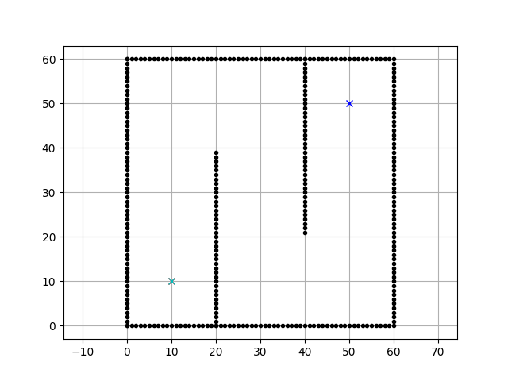
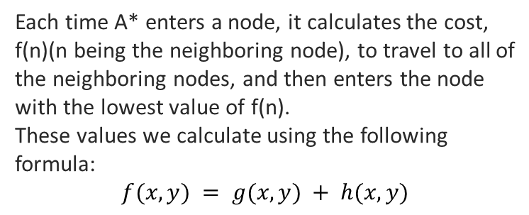
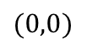
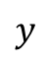
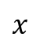
A star method example
Wall (obstacles) cannot be touched!
Each time A* enters a node, it calculates the cost, f(n)(n being the neighboring node), to travel to all of the neighboring nodes, and then enters the node with the lowest value of f(n).
These values we calculate using the following formula:
$$f(x,y) = g(x,y) + h(x,y)$$
destination
$$y$$
Shortest Trajectory
$$(0,0)$$
$$x$$
Source: PythonRobotics
https://towardsdatascience.com/a-star-a-search-algorithm-eb495fb156bb

Slide 11
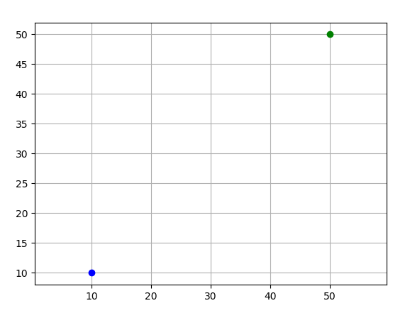
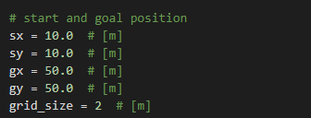
Code: set up start and goal node
Goal node
Set up the start and goal nodes using the code
Start node
Start node
Goal node

Slide 12
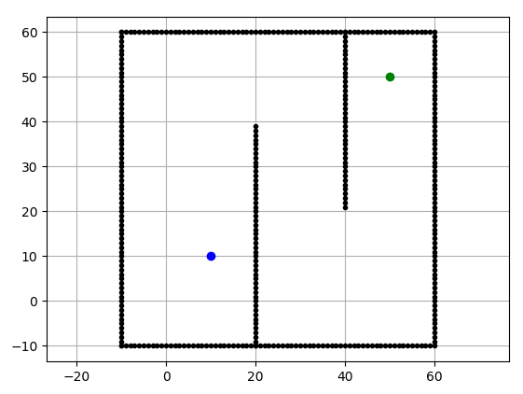
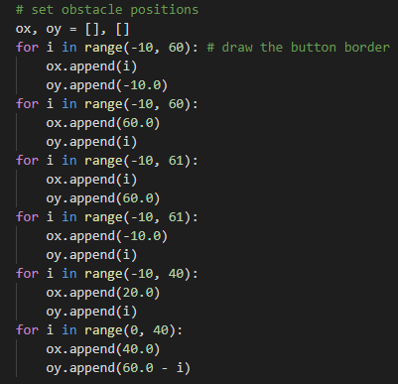
Code: set up obstacle
Set up the obstacle using the code
Start node
Goal node
Obstacle (wall)

Slide 13
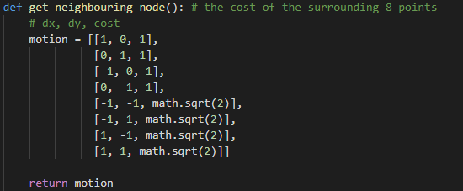
Code: neighboring node search
neighboring node search
Start node
Goal node
Obstacle (wall)

Slide 14
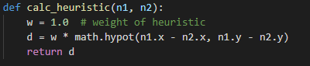
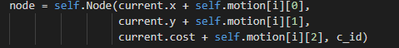


Code: cost calculation
Heuristic cost$g(x,y)$ calculation
exact cost $g(x,y)$calculation

Slide 15
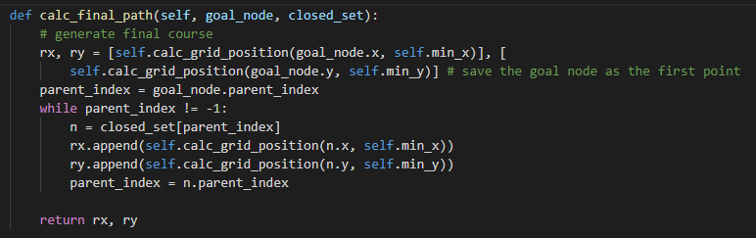
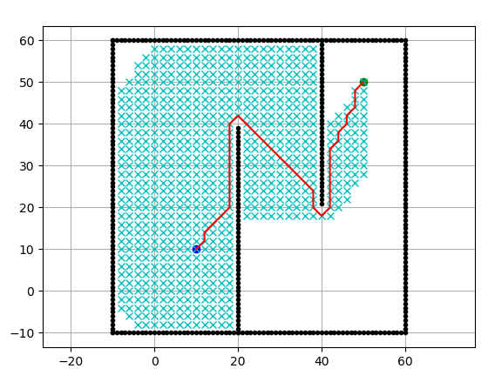
Code: calculation of final path

Slide 16
Additional Cost.

Slide 17

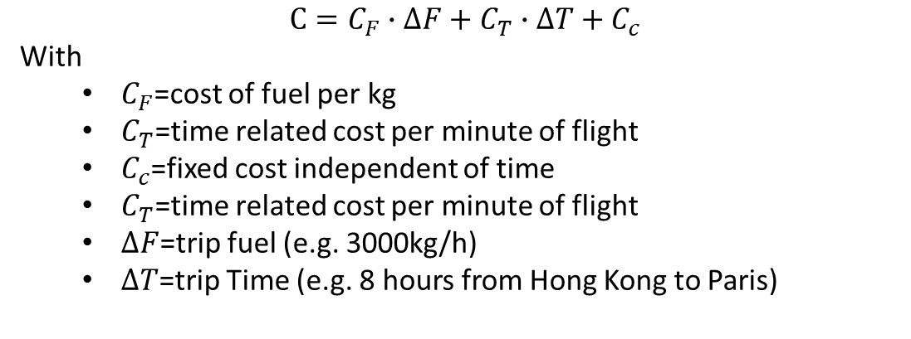
Flight planning considering trip cost
The fundamental rationale of the cost index concept is to achieve minimum trip cost by means of a trade-off between operating costs per hour and incremental fuel burn.
$$C=C_{F}∙∆F+C_{T}∙∆T+C_{c}$$
With
$C_{F}$=cost of fuel per kg
$C_{T}$=time related cost per minute of flight
$C_{c}$=fixed cost independent of time
$C_{T}$=time related cost per minute of flight
$∆F$=trip fuel (e.g. 3000kg/h)
$∆T$=trip Time (e.g. 8 hours from Hong Kong to Paris)
Can we consider this cost to our path planning to imitate the path planning for flights?

Slide 18
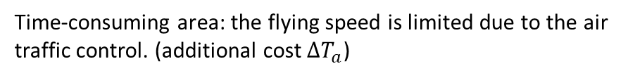
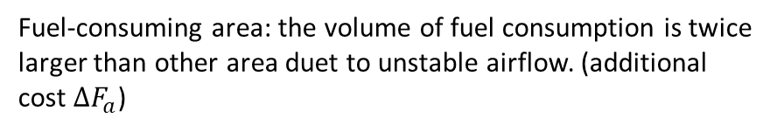
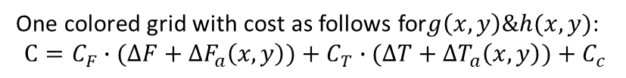

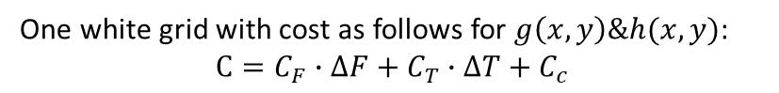
Flight planning considering trip cost
Fuel-consuming area: the volume of fuel consumption is twice larger than other area duet to unstable airflow. (additional cost $∆F_{a}$)
Time-consuming area: the flying speed is limited due to the air traffic control. (additional cost $∆T_{a}$)
Cost can be calculated using the following formula:
$$f(x,y) = g(x,y) + h(x,y)$$
One white grid with cost as follows for $g\left(x,y\right)\&h(x,y)$:
$$C=C_{F}∙∆F+C_{T}∙∆T+C_{c}$$
Start node
Goal node
One colored grid with cost as follows for$g\left(x,y\right)\&h(x,y)$:
$$C=C_{F}∙(∆F+∆F_{a}\left(x,y\right))+C_{T}∙(∆T+∆T_{a}\left(x,y\right))+C_{c}$$

Slide 19
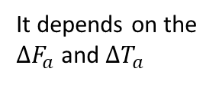
How we choose the routes ?
Fuel-consuming area: the volume of fuel consumption is twice larger than other area duet to unstable airflow. (additional cost $∆F_{a}$)
?
?
Time-consuming area: the flying speed is limited due to the air traffic control. (additional cost $∆T_{a}$)
Cost can be calculated using the following formula:
$$f(x,y) = g(x,y) + h(x,y)$$
One white grid with cost as follows for $g\left(x,y\right)\&h(x,y)$:
$$C=C_{F}∙∆F+C_{T}∙∆T+C_{c}$$
Start node
Goal node
One colored grid with cost as follows for$g\left(x,y\right)\&h(x,y)$:
$$C=C_{F}∙(∆F+∆F_{a}\left(x,y\right))+C_{T}∙(∆T+∆T_{a}\left(x,y\right))+C_{c}$$
It depends on the $∆F_{a}$ and $∆T_{a}$

Slide 20
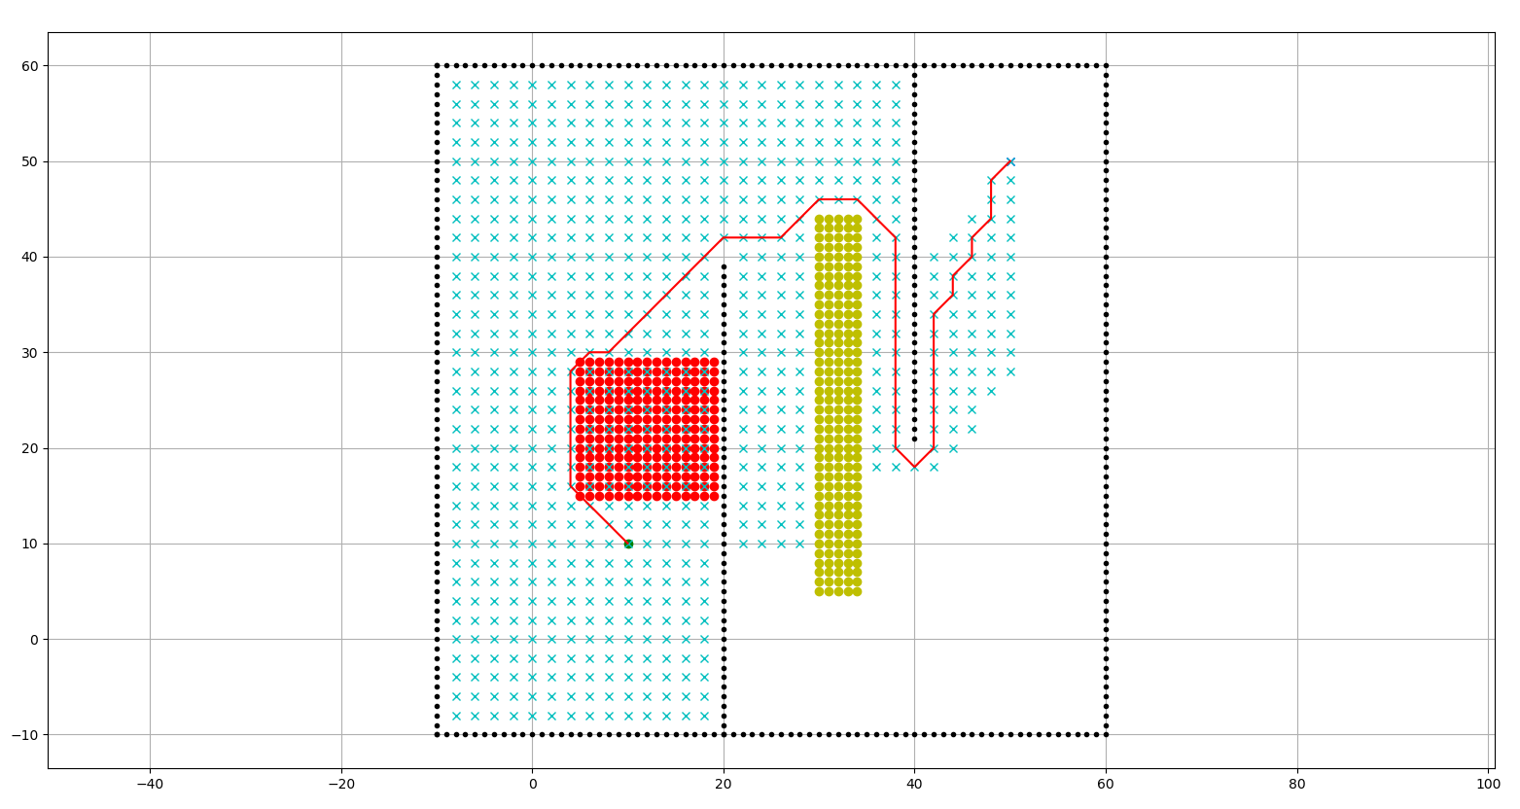
Example route planning
Fuel-consuming area
Time-consuming area
Trajectory
Avoiding the Fuel-consuming and time-consuming area if their cost is too high?

Slide 21
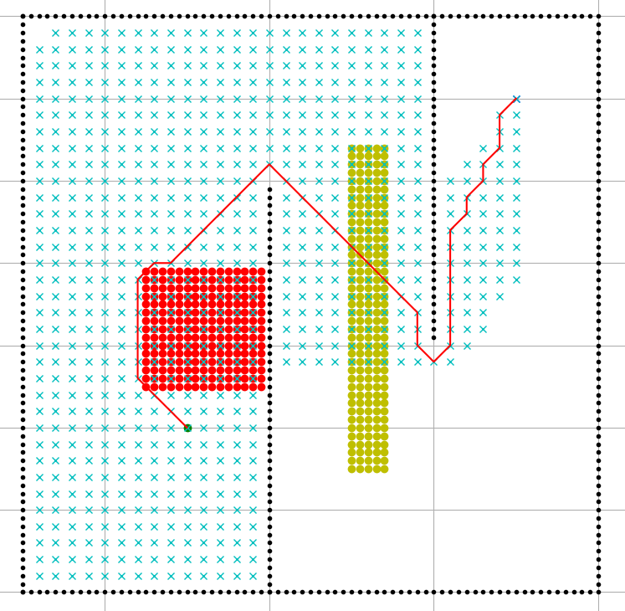
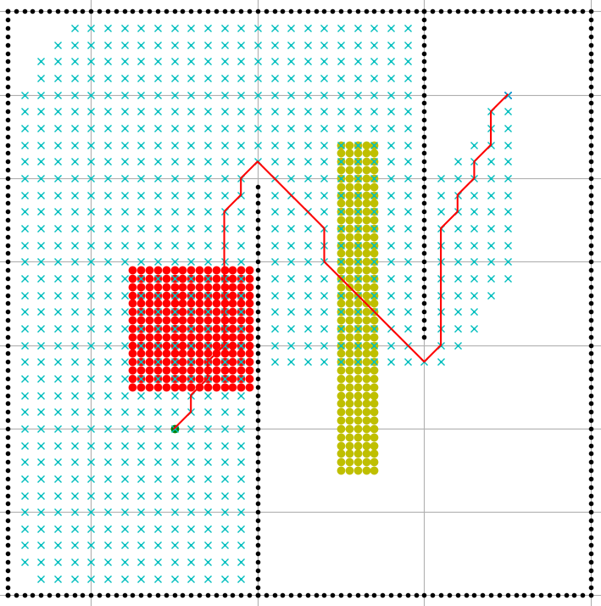
Example route planning
Go through the fuel-consuming and time-consuming area if their additional cost is quite small?

Slide 22
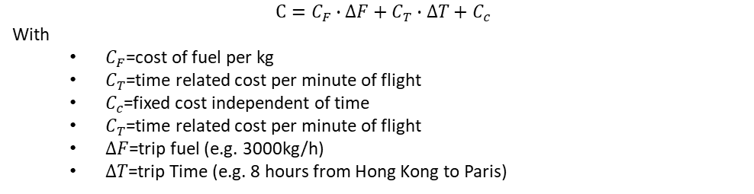
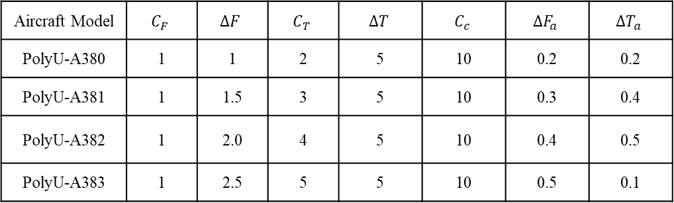
Design your route
Aircraft Model | $$C_{F}$$ | $$∆F$$ | $$C_{T}$$ | $$∆T$$ | $$C_{c}$$ | $$∆F_{a}$$ | $$∆T_{a}$$
PolyU-A380 | 1 | 1 | 2 | 5 | 10 | 0.2 | 0.2
PolyU-A381 | 1 | 1.5 | 3 | 5 | 10 | 0.3 | 0.4
PolyU-A382 | 1 | 2.0 | 4 | 5 | 10 | 0.4 | 0.5
PolyU-A383 | 1 | 2.5 | 5 | 5 | 10 | 0.5 | 0.1
$$C=C_{F}∙∆F+C_{T}∙∆T+C_{c}$$
With
$C_{F}$=cost of fuel per kg
$C_{T}$=time related cost per minute of flight
$C_{c}$=fixed cost independent of time
$C_{T}$=time related cost per minute of flight
$∆F$=trip fuel (e.g. 3000kg/h)
$∆T$=trip Time (e.g. 8 hours from Hong Kong to Paris)

